Slide 1
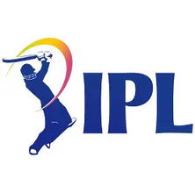

THE 2016 PIVOT :
A NEW TITLE SPONSOR PROPOSAL

Slide 2
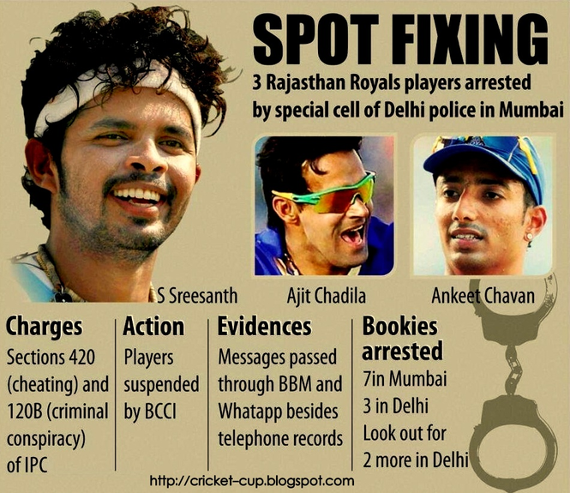


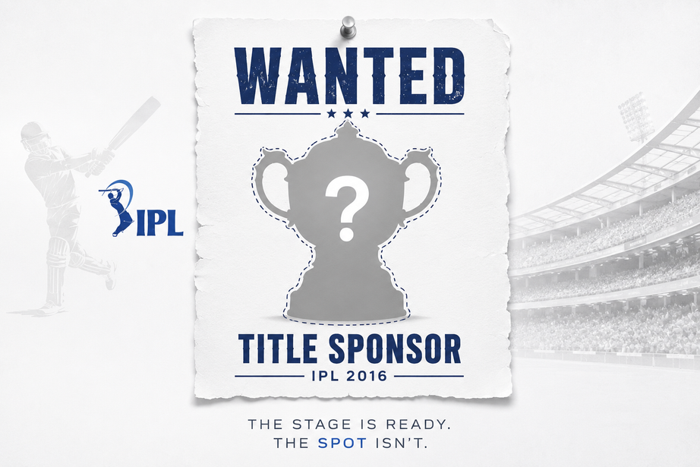
THE CRISIS (2013–2015)
Who was affected?
Why did this matter?
What happened to IPL's image?

Slide 3
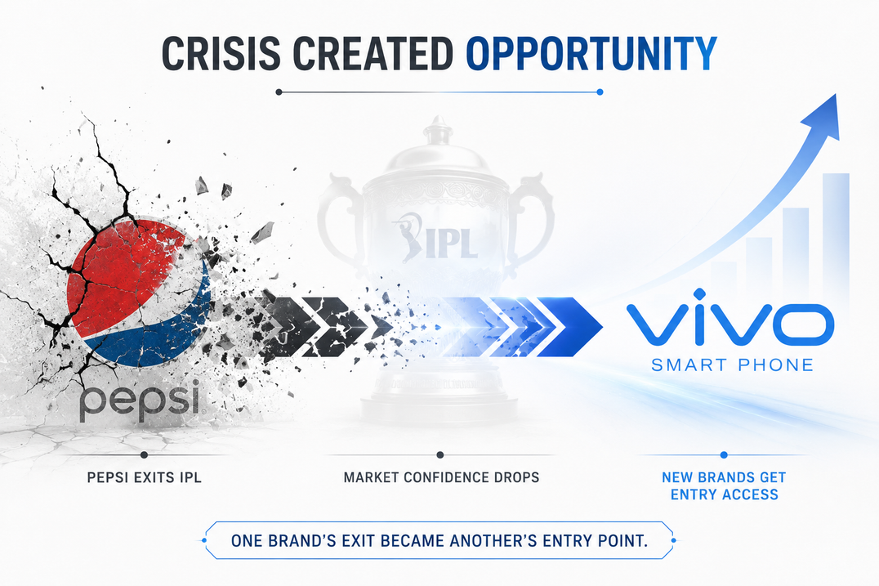
THE EXIT
Pepsi exits IPL
Market confidence drops
Mass confusion at the panel

Slide 4
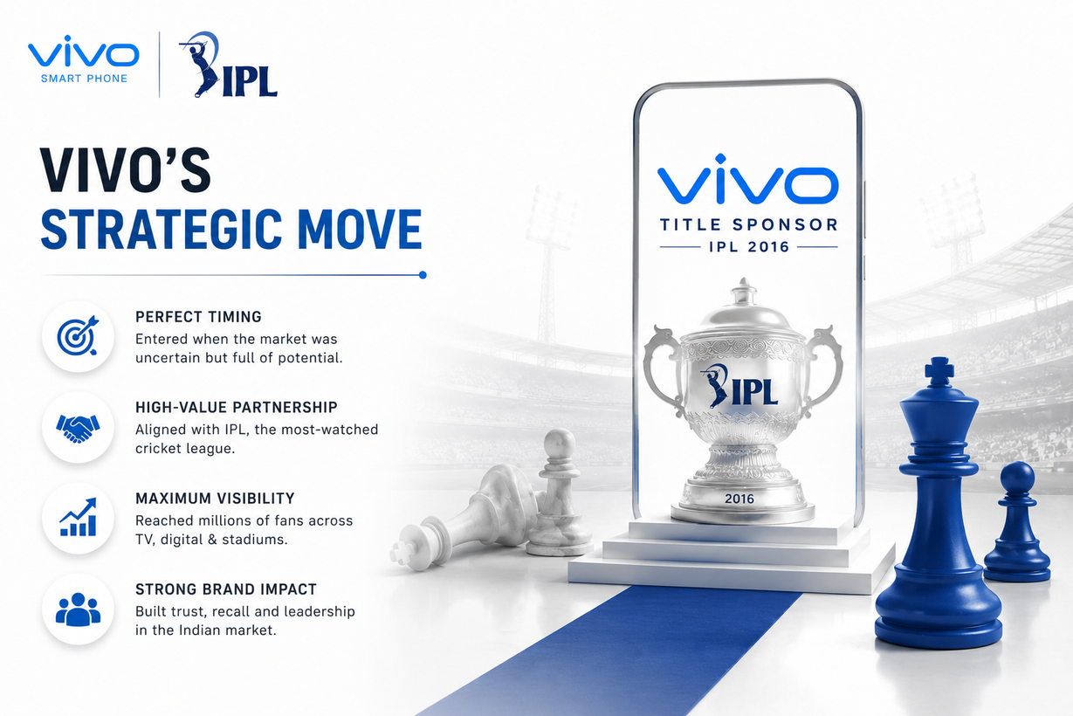
LESSONS FROM FAILIURE
Conducted internal reviews
Strengthened anti-corruption measures
Improved transparency & accountability

Slide 5

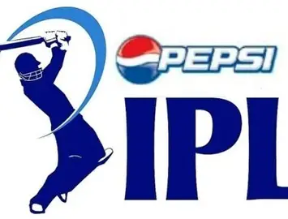
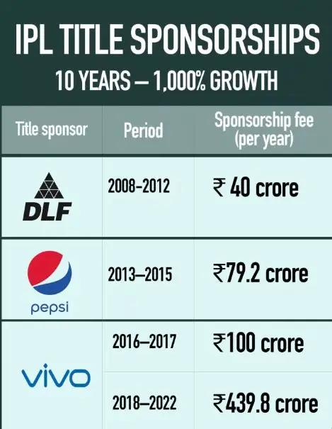

VIVO X IPL
A partnership built on resilience
Unmatched reach and engagement
Vivo's opportunity with a transformed IPL

Slide 6



